Slide 1
Cookbook for Practice 6.1
实践6.1攻略
Cong Li 李聪

Slide 2
Change Data Type
改变数据类型 (1)
Duplicate ‘multithread.cpp’ as ‘float.cpp’
将’ multithread.cpp’复制为’float.cpp’
Change double-precision data types to single-precision data types
将双精度类型改成单精度类型

Slide 3
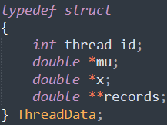
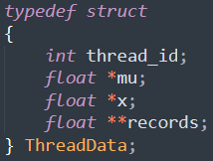
Change Data Type
改变数据类型 (2)

Slide 4




Change Data Type
改变数据类型 (3)

Slide 5
Run It 运行之
Change the print data type format from ‘lf’ to ‘f’
将打印的数据类型格式从’lf’改为’f’
Compile & run it 编译并运行之
mingw32-make SRC=float.cpp NATIVE=1
run-float.exe

Slide 6
The End

